Slide 1

Duke SmartHome: Electrical inventory
Basement
Main level
First level

Slide 2
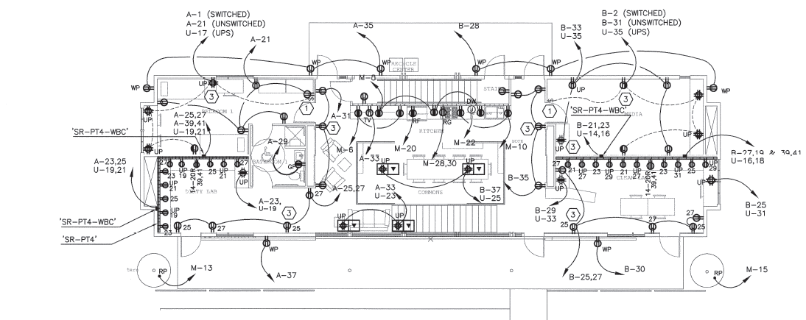
Main level plan-Power
North facade
Kitchen
Media room
Common room
Clean lab
Dirty lab
South facade
Back to building

Slide 3
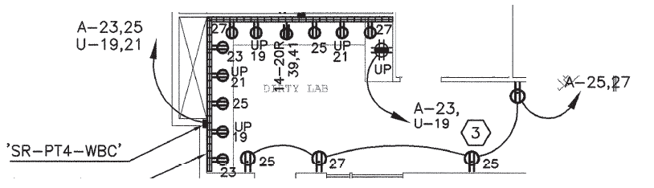
Clean lab
Verified
Problem: read notes
Screen1
PC2+screen2
PC1
Empty
PC3
Back

Slide 4
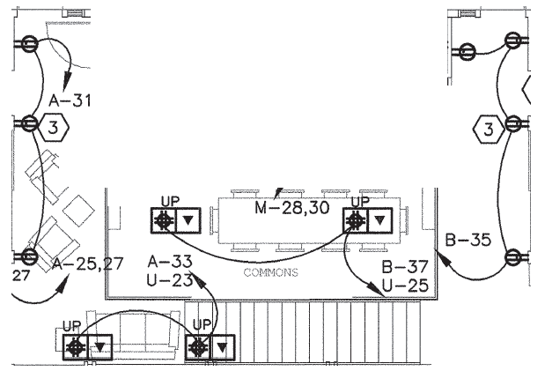
Common room
Verified
Problem: read notes
Empty
Speaker2
Stereo1
Not found
Speaker3
Back
A-33, U-23 not found

Slide 5
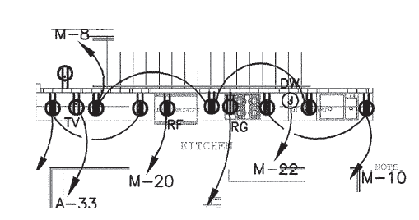
Kitchen
Verified
Problem: read notes
Empty
Empty
Empty
Dish washer
Coffe-maker
Empty
Speaker
Microwave
Toaster
oven
Range
Refrigerator
Back
To verify if oven and range are connected

Slide 6
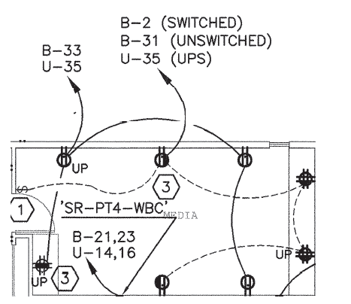
Media room
Verified
Problem: read notes
empty
empty
empty
empty
Stereo2 + pc8
empty
TV1
pc7
Back
TV2
decoder
Additional receptacle B-CKT q
Additional receptacle B-36

Slide 7
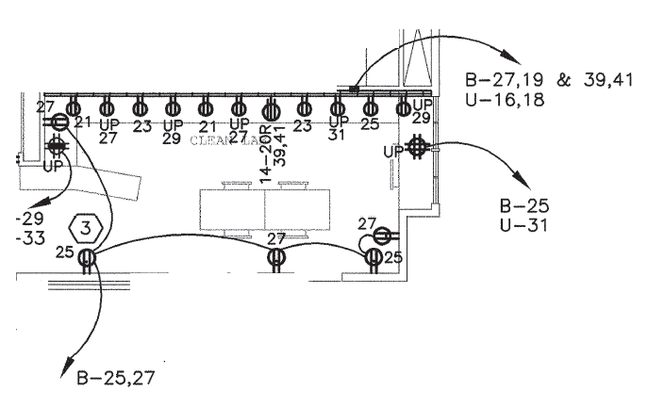
Dirty lab
Verified
Problem: read notes
Pc4+ hand vac
PC5
PC6
Empty
Empty
Back
All PCs miss technical specification
Hand vac misses power

Slide 8
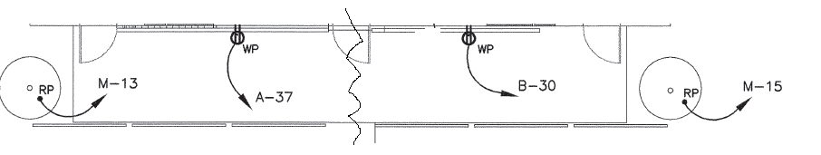
South facade
Verified
Problem: read notes
Empty
Empty
Irrigation controller
Irrigation controller
Back
1) Irrigation controller to be verified

Slide 9
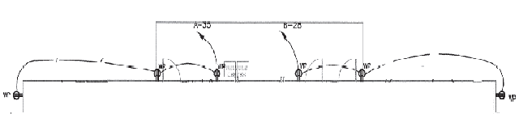
North facade
Verified
Problem: read notes
Lawn mower
Empty
Back
Gas flow meter to verify

Slide 10
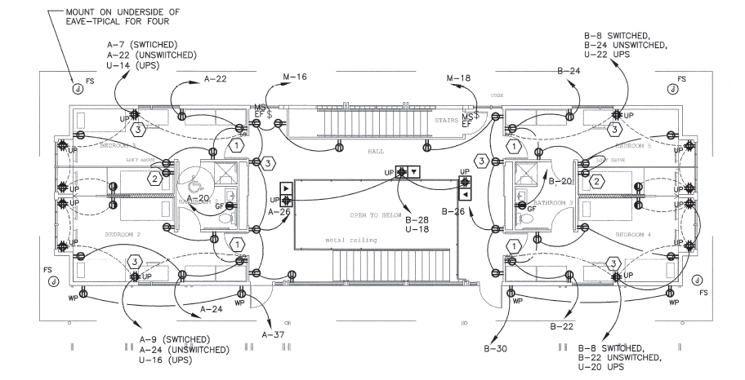
First level
Hall
Balcony
Back to building

Slide 11
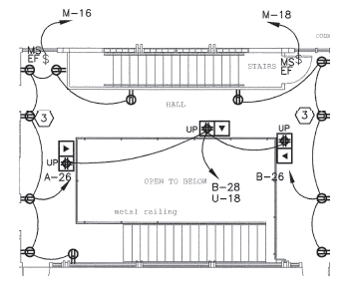
Hall
Verified
Problem: read notes
Refrigerator+ CO2 detector
Washing machine??
Empty
Empty
Empty
Empty
Empty
Empty
Empty
Empty
Wireless doorbell
Not found
Empty
Back
Floor circuit not found except for the central receptacle
Connections washing machine??

Slide 12
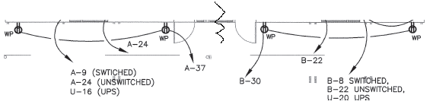
Balcony
Verified
Problem: read notes
Empty
Back

Slide 13
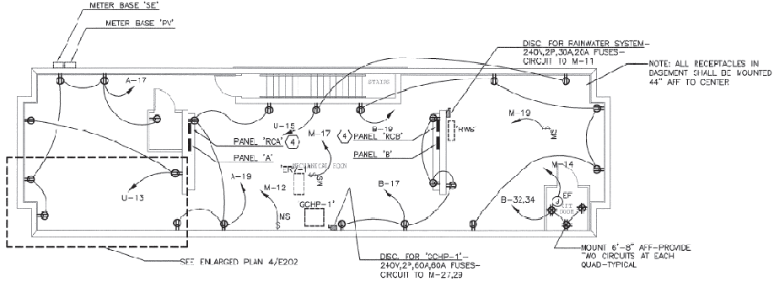
Basement
West
Central
East
Back to building

Slide 14
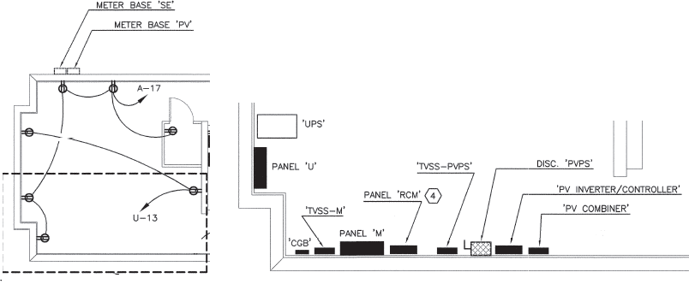
West
Verified
Problem: read notes
Inverter controller
Phone
Not found
Oscilloscope
Empty
Back
Panel section faces north in reality
U-13 not found

Slide 15
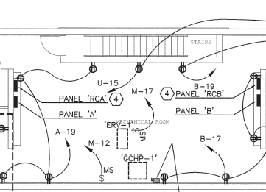
Central
Verified
Problem: read notes
Empty
Empty
Empty
Empty
Fan??
Empty
Pump
Empty
Back
1) Fan needs to be verified

Slide 16
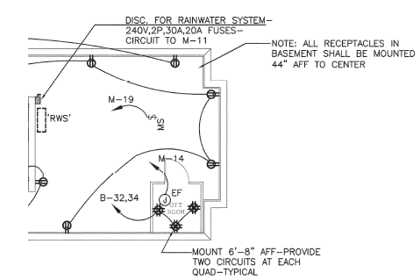
East
Verified
Problem: read notes
Network interface
Boiler
CO2 detector
Empty
Empty
Back
Electrical boiler or drainage tank
Network interface needs to be verified (specifications needed also)

